Slide 1
Basic Usage of Git
zhiong

Slide 2
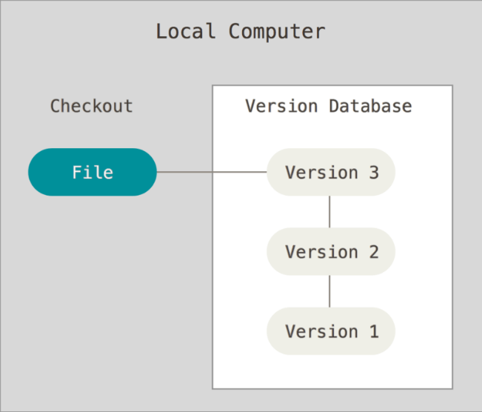
Version Control
Local Version Control Systems

Slide 3
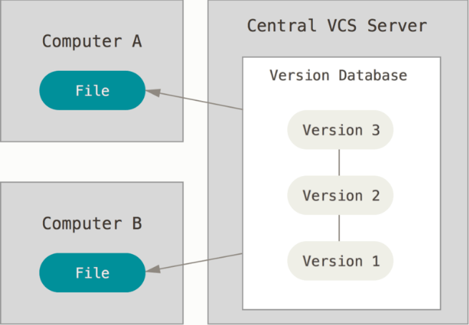
Version Control
Centralized Version Control Systems

Slide 4
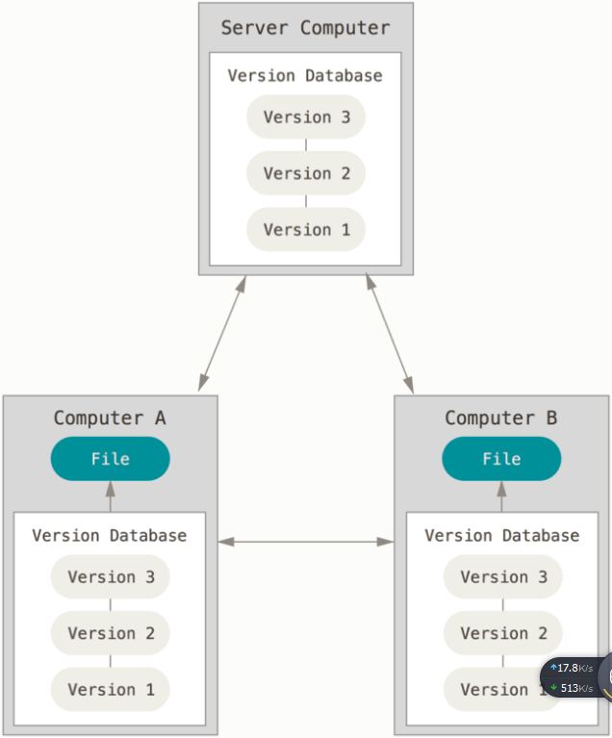
Version Control
Distributed Version Control Systems

Slide 5
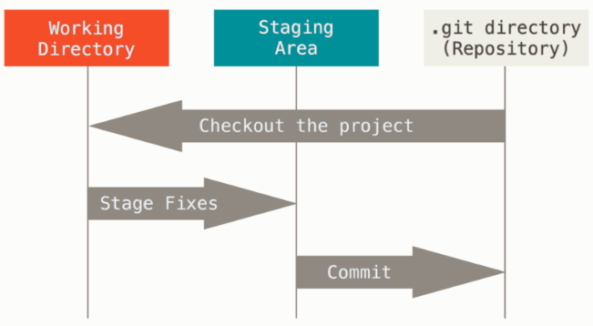
Working Areas

Slide 6
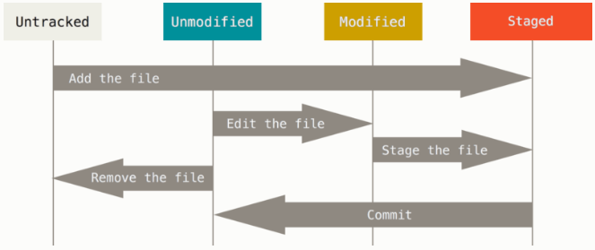
File Status

Slide 7
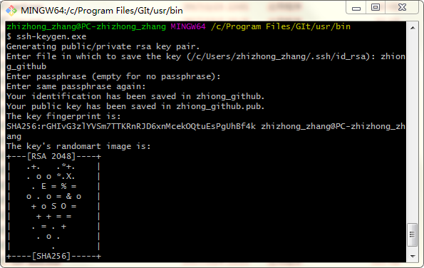
Config
Your Identity
  git config --global user.name “xxx“
  git config --global user.email xxx@xxx.com
  .ssh key
    ssh-keygen
Checking Config
  git config –list

Slide 8
Getting a Git Repository
Method
  git init
  git clone url

Slide 9
GitHub
Register
Create Response
Add public key
Clone to local
Fork from other open source code

Slide 10
Record Changes
git status
git add
git commit
git rm
git mv
git diff
git log
git checkout
git reset
git push

Slide 11
Git Branch
Create
  git checkout –b xxx
  Git branch
Merge
  git merge xxx
Delete
  Git branch –d / -D xxx
Index
  git checkout xxx

Slide 12
Working with Remote*
Show Remote
  git remote –v
  git remote add remote_name ref_url
Fetching and Pulling from Remotes
  git fetch name
Pushing Remotes
  git push remote_name branch_name
Rename & Removing Remotes
  git remote rename remote_old_name new_name
  git remote remove remote_name

Slide 13
Reference
Help
  Git help <verb>
www
  https://www.git-scm.com/doc

